Slide 1
An Introduction to FEAST
Ellie Allen, FEAST Programme Manager

Slide 2
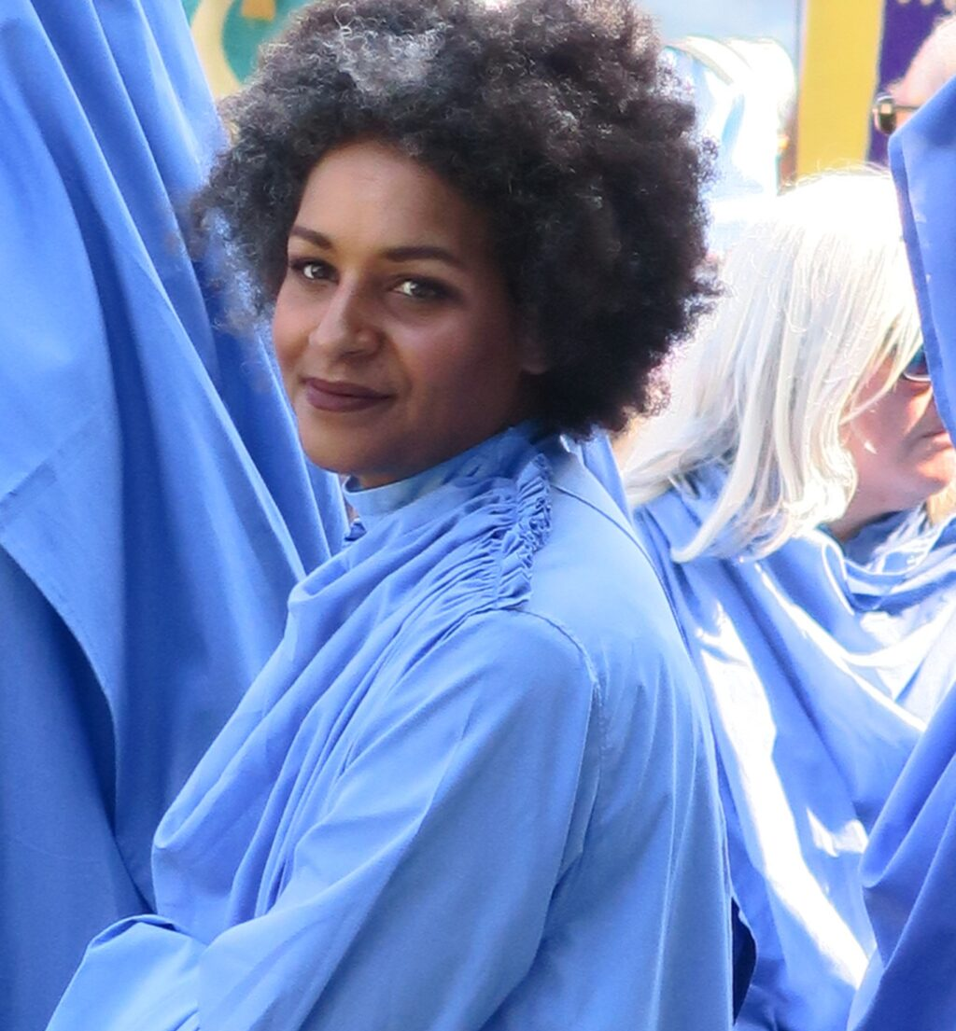
Ellie Allen Programme Manager Ellie@creativekernow.org.uk

Slide 3
Who are Creative Kernow?
Creative Kernow
Creative Economy Support
Creative Hub Development
Creative Communities
Cornwall365
Screen Cornwall
Krowji
Carn to Cove
FEAST
C-Fylm
Arts Lab

Slide 4
FEAST
Why does FEAST exist?
What are FEAST grants for?
Who can apply for FEAST grants?
What can you use FEAST grants for?
How much can you apply for from FEAST?

Slide 5
How does it work?
Application form.
Book an appointment.
The FEAST roadshow.
Interviews.

Slide 6
Top Tips for applying
Have you referred to the criteria / guidelines?
When does your project start?
Is your budget understandable?
Do you have enough match funding?

Slide 7
FEAST Festival’s Network
What is the FEAST Festival’s Network?
Who can be a member of the network?
What are the benefits of being a network member?
Funding for festivals.

Slide 8
Upcoming FEAST Deadlines
Main Grants – Participation
Monday 29th April
Open Smaller Grant
Monday 3rd June
Festival Enhancement Grant
Monday 3rd June

Slide 9
4th – 6th October 2024

Slide 10
ANY QUESTIONS?

