Slide 1
The National Lottery Heritage Fund
Meet the Funders April 2024
heritagefund.org.uk

Slide 2
What do we do?
UK's largest funder of heritage
Our vision is for heritage to be valued, cared for and sustained for everyone, now and in the future
10-year strategy Heritage 2033
£3.6 billion investment
Notes:
10:11 DAWN:
SO - to the Heritage Fund…
We are the largest funder for the UK's heritage…using 20% of National Lottery good cause money to fund groups like yourselves to deliver heritage projects. Since 1994 we have invested £8.8 billion pounds in 51,000 heritage projects across the UK!
The Heritage Fund’s vision is for heritage to be valued, cared for and sustained for everyone now and in the future. And we will do this by funding projects that bring out benefits for people, places and our natural environment. You could be a heritage organisation or a community organisation as long as you are interested in connecting people and communities to heritage in the UK you're in the right place.
We will put the link to our website in the chat – We will be putting links in the chat as we go along, but don’t worry you don’t need to read these now, they are just there if you want a quick look.
**PRODUCER SHARE LINKS** The National Lottery Heritage Fund: Home
We have recently launched our new strategy, Heritage 2033, which sets out our principles and ambitions for the next 10 years, helping us take a longer-term view for investing a further £3.6 billion in heritage in the UK. It would be a really good idea to read our strategy as it lays everything out simply, and we have included a link here as it only takes about 10 minutes to read and gives you a really clear idea about what we want to achieve.
**PRODUCER SHARE LINKS** Heritage 2033 – our 10-year strategy | The National Lottery Heritage Fund & Heritage 2033 delivery plan: 2023–2026 | The National Lottery Heritage Fund
You might be pleased to know we have simplified our application form and monitoring process and now all our funding decisions are centered around four investment principles!

Slide 3
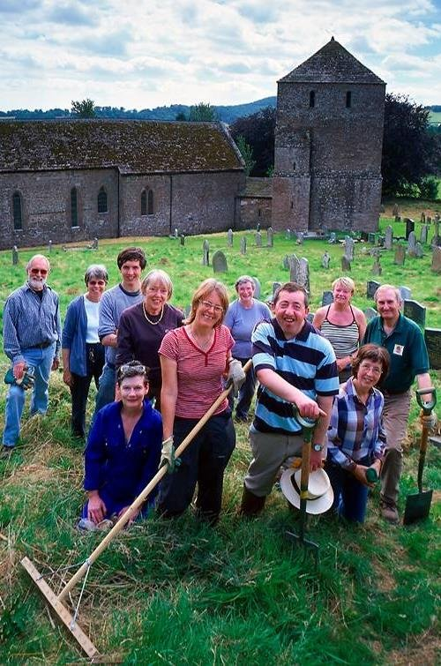
Who do we fund?
not-for-profit organisations
private owners of heritage assets
partnerships
And what do we fund?
Projects that connect people and communities to the UK's heritage
St Michael’s, Garway, Herefordshire
Notes:
10:23 DAWN:
You might be keen to know WHO we fund! – So - under this programme, we accept applications from not-for-profit organisations, private owners of a heritage asset and partnerships.
Here are some examples of the types of organisations we fund:
**read quickly**
charities, trusts and CIO’s (charitable incorporated organisations)
community and voluntary groups and CIC’s (community interest companies)
community and parish councils
faith based or church organisations
local authorities and other public sector organisations
**breathe**
private owners of a heritage asset, for example, a building, land, object or collection
AND partnerships…usually made up of a combination of these…we class a partner as another organisation or third-party body that is integral to the delivery of your project.
Organisations need to have a bank account, a governing document, and two or more members that are not related or living at the same address.
If after reading the guidance online you remain unsure about eligibility…please contact your local team.
NOW - WHAT do we fund – We fund projects connecting people with the UK’s Heritage. Projects that value, care for and sustain heritage for everyone across the UK, now and in the future.
**PRODUCER PASTE LINK** What we fund | The National Lottery Heritage Fund
Importantly we don’t define heritage – we see it as anything from the past that you value and want to pass on to future generations.
We support a wide range of heritage from museums, libraries and archives; to historic buildings; to nature and habitats; from our industrial legacy; to cultural traditions, stories and memories; celebrations and more....
Heritage can mean different things to different people BUT Heritage is about what is important to you!
If you are struggling to explain your heritage - either the heritage itself or the importance of it to your community - there is a great new section on our website which offers some hints, tips and questions to help you more fully understand your heritage. Please have a look and share it with the people planning your project.
**PRODUCER PASTE LINK** Understanding your heritage | The National Lottery Heritage Fund
It is also useful to know now that WE CANNOT FUND any works that would be considered your organisation’s statutory responsibility; we can’t cover existing costs or any activity that has taken place before the grant is awarded OR fund a project that promotes the cause or beliefs of political or faith organisations. We also can’t fund artificial grass (for environmental reasons – doing our bit!)
I think that is enough from me!...

Slide 4
Thanks to National Lottery players, since 1995 we have invested more than £970 million in places of worship across the UK
St Michael & All Angels Church, Berwick, Polegate, East Sussex
Notes:
The Cheetham school workshop in a synagogue. Credit: Chris Payne

Slide 5
Heritage 2033
As the largest funder for the UK’s heritage, our vision​ is for heritage to be valued, cared for and sustained​ for everyone, now and in the future.
Our new Heritage 2033 strategy is underpinned by​ four investment principles. All four principles need to​ be considered in applications for funding, the​ strength of focus on each principle is for applicants​ to decide.
Holy Trinity Church, Hastings, East Sussex
Notes:
11:48 LAURA:
Thanks KAT. Once again, we have covered quite a lot of information in that section. We are going to take a few minutes to see if there are any questions on the application form, if you have any questions please send these in the chat OR If you would like to come on camera to ask a question, please raise your hand using the function.
**PAUSE A MIN FOR TYPING / CHAT CHECK**
We have had a few questions in the chat about that section which we will answer (field the questions to the hosts)
**Question control measures if needed**
I will now hand over to DAWN to take us through the final section before we wrap up the session for today.

Slide 6
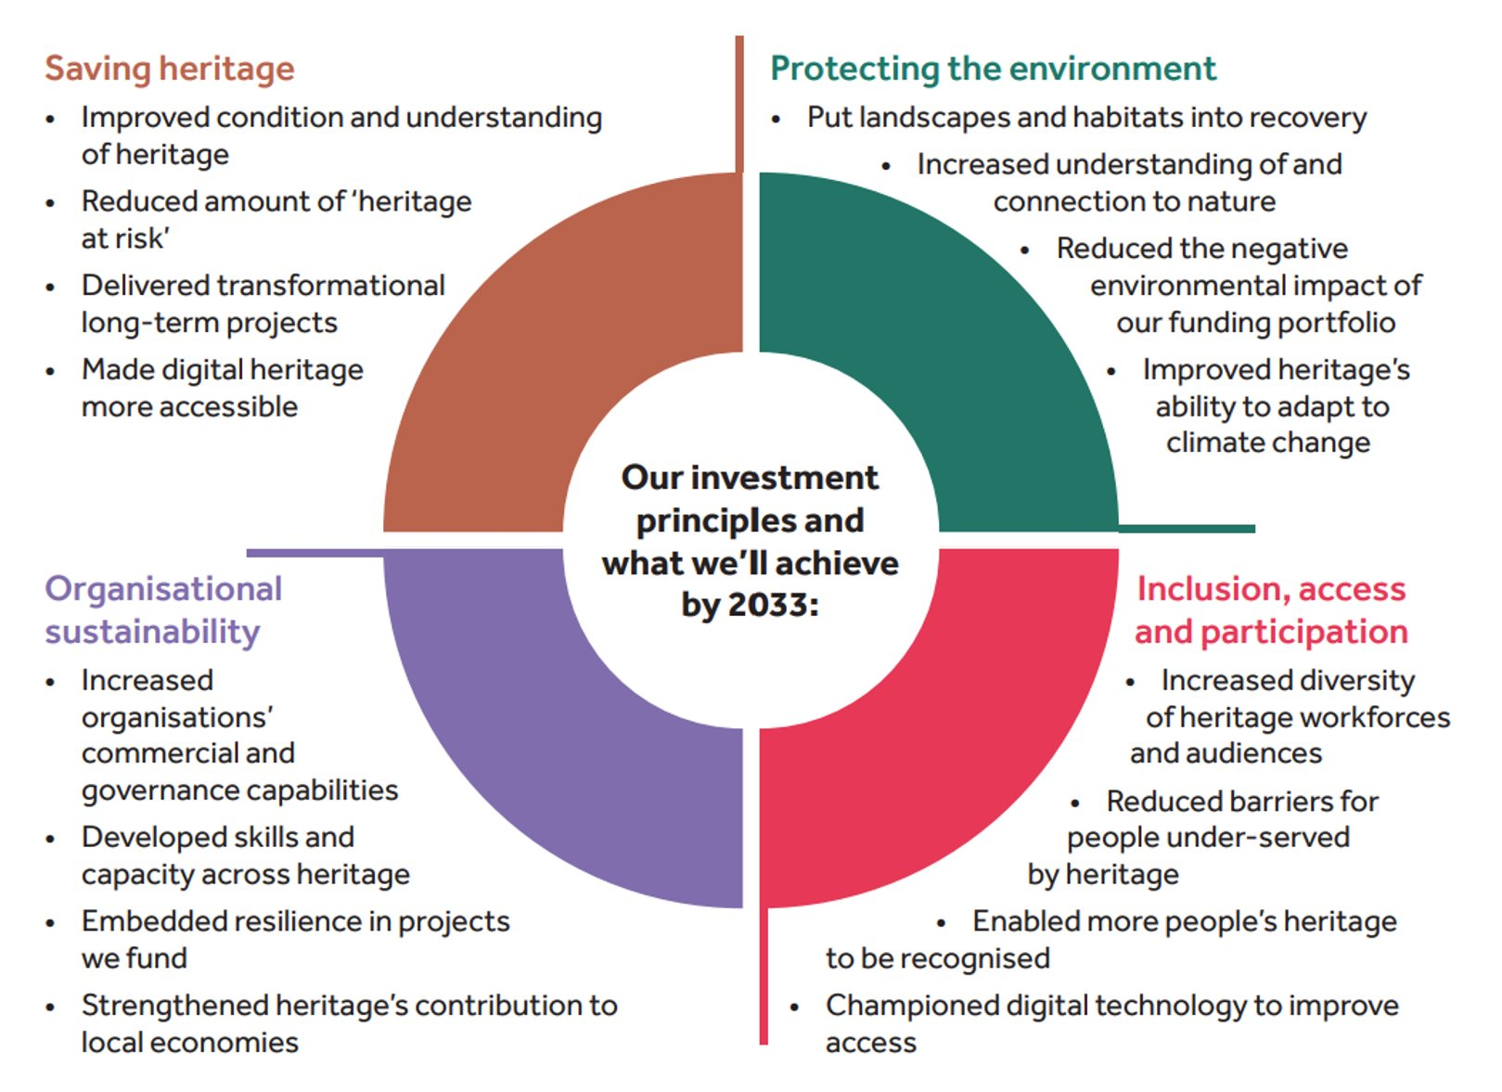

Slide 7
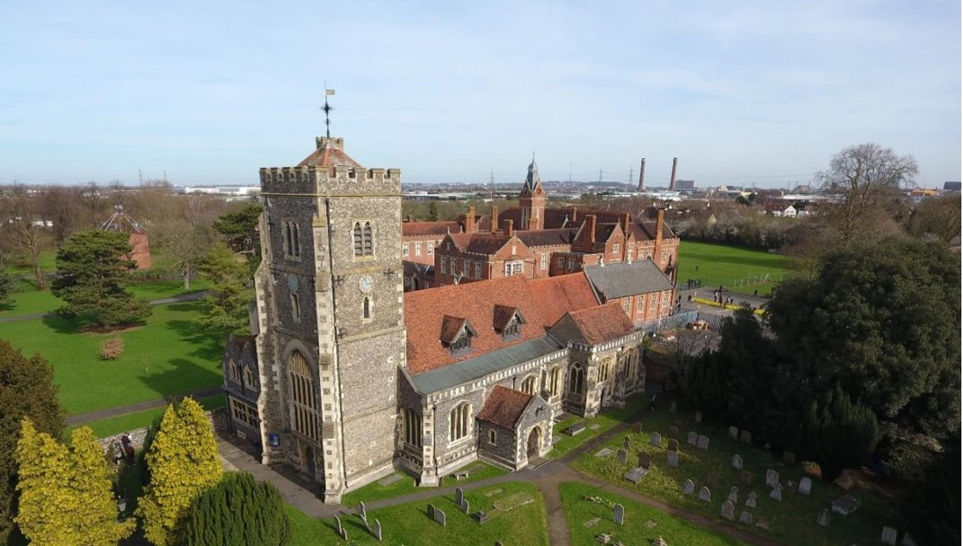
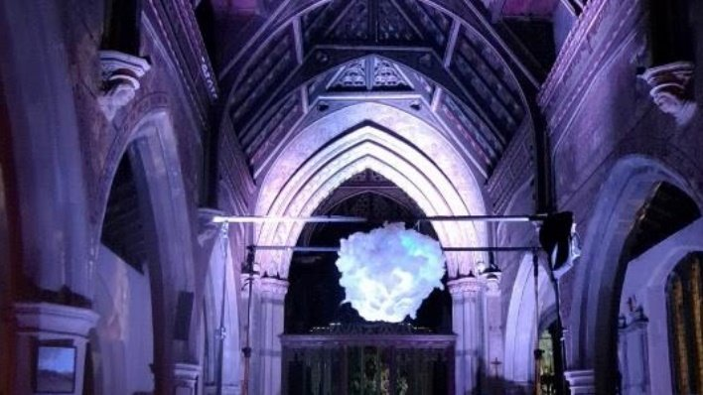
Case study​
​Restoring and celebrating the Arts and Craftsmanship of St Mary’s, Beddington, London
£209,600 awarded from the Heritage Fund
Saving Heritage Historic fabric repairs​ to woodwork Structural repairs to roof
Organisational Sustainability Appointed Heritage Programme Manager and governance training for PCC​ On-site training for 2 apprenticeships​
Inclusion, Access and Participation Music workshop for people with Special Educational Needs Arts and crafts activity days, working with local museum
Protecting the Environment Improving energy efficiency through repairs to roof

Slide 8
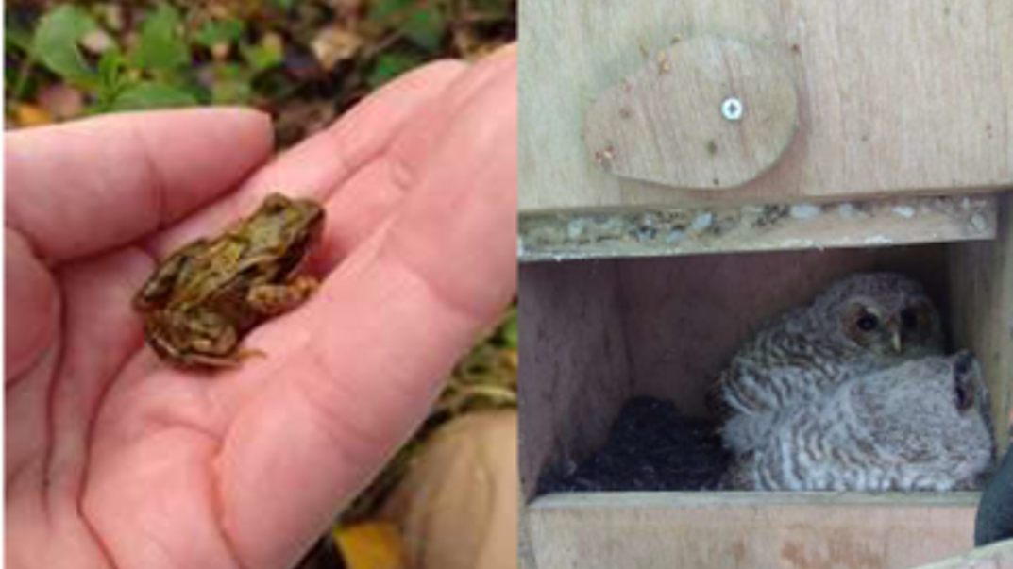
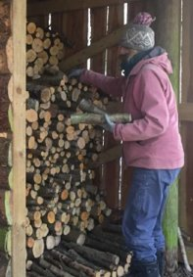
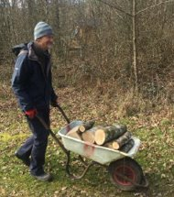
Case study​
​Conservation for Wellbeing​ Hazel Hill Wood, Salisbury, Wiltshire
£10,000 awarded from the Heritage Fund
Saving Heritage Conservation of ancient woodland habitats
Organisational Sustainability Improved resilience and financial stability of organisation through increased activity programme, reaching new audiences
Inclusion, Access and Participation Engaging people experiencing mental health issues with woodland environment Woodland activity programme including moth mornings, bat and glowworm nights, bug hunting, pond dipping
Protecting the Environment Skills development in caring for woodland ecosystems
Raising the profile of environmental and sustainability issues

Slide 9
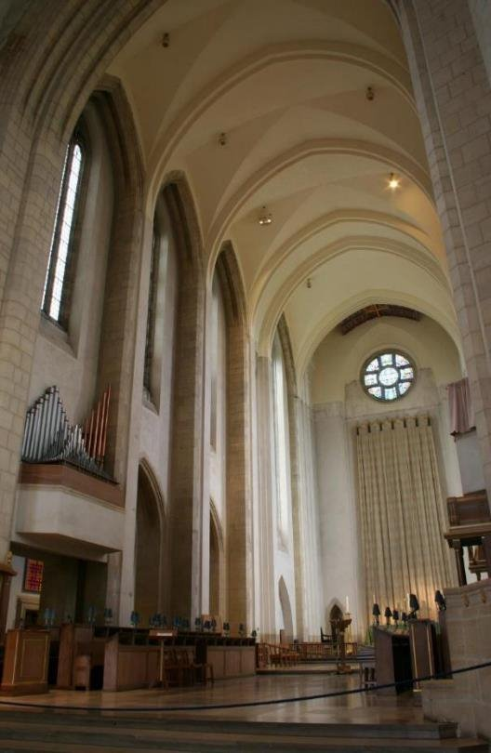
Our funding programmes
£10,000 - £250,000 National Lottery Heritage Grants
Rolling submission dates
Project enquiry: optional before submitting application
£250,000 - £10million National Lottery Heritage Grants
Quarterly submission dates
Expression of interest: compulsory, and if successfully passed, applicant has 12 months to then submit a development application
Two phases:
Development application: up to two years duration. Activities include detailed design, planning work, and any surveys or investigations needed
Delivery application: up to five years duration, delivering the planned capital works and activities
Guildford Cathedral, Guildford, Surrey

Slide 10
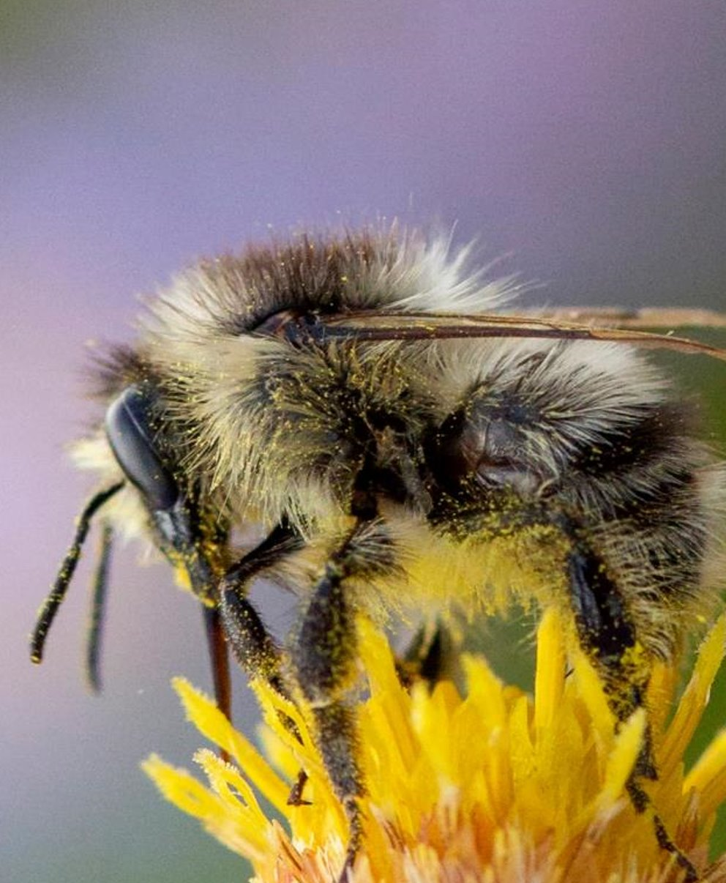
Resources
www.heritagefund.org.uk
project enquiry forms
webinars
understanding heritage toolkit
application questions guidance
receiving a grant / terms of grant
good practice guidance
acknowledgement toolkit
case studies, news and blogs
Notes:
11:48 LAURA:
Thanks KAT. Once again, we have covered quite a lot of information in that section. We are going to take a few minutes to see if there are any questions on the application form, if you have any questions please send these in the chat OR If you would like to come on camera to ask a question, please raise your hand using the function.
**PAUSE A MIN FOR TYPING / CHAT CHECK**
We have had a few questions in the chat about that section which we will answer (field the questions to the hosts)
**Question control measures if needed**
I will now hand over to DAWN to take us through the final section before we wrap up the session for today.

Slide 11
Thank you
Notes:
11:48 LAURA:
Thanks KAT. Once again, we have covered quite a lot of information in that section. We are going to take a few minutes to see if there are any questions on the application form, if you have any questions please send these in the chat OR If you would like to come on camera to ask a question, please raise your hand using the function.
**PAUSE A MIN FOR TYPING / CHAT CHECK**
We have had a few questions in the chat about that section which we will answer (field the questions to the hosts)
**Question control measures if needed**
I will now hand over to DAWN to take us through the final section before we wrap up the session for today.

