Slide 1

Nottingham City Council
Housing Strategy
&
Housing Demand Overview
Ruth Stallwood – Housing Strategy Specialist
Leon McLean – Strategic Housing Projects Officer
Emma James - Prevention and Assessment Manager
Notes:
Ruth – over view of the housing market and population – some key information pertinent to affordable housing
Leon – Social housing
Emma - NPRAS

Slide 2
National context
Cost of living crisis
Housing crisis
Fuel Poverty
Food poverty
High inflation
Notes:
On the screen are various terms that you’ll recognise that describe the varied financial pressures that households across the country and in Nottingham are facing
These affordability crises are affecting households in all tenures but low-income households especially those in private rented accommodation are especially impacted
household expenditure on essentials are going up more than the average household income and this cost-of-living crisis has been with us since late 2021
An under supply of housing is affecting the cost of both buying and renting a homes and further exacerbating the affordability of housing
This current crisis combined with existing issues such as rising rents, low wages and a lack of affordable housing has created a perfect storm for people who were already struggling.

Slide 3
Nottingham context
Population
Nottingham has 7th highest population density outside London
Estimated that over 337,000 people currently live in Nottingham
  population projected to increase by over 15,000 people over the next 10 years
1 in 7 people in the city are students
Ethnic minority groups make up 42.7% of Nottingham’s population
Deprivation
Nottingham ranked the 11th most deprived District in the Country
Nottingham’s unemployment rate is 7.8% compared to a national rate of 6.4%
Overall 6.0% of homes are overcrowded in Nottingham compared to 4.4 % in England
36% of Nottingham households have at least one person with a disability, the England average is 32%
Notes:
Nottingham is a great city - bustling, diverse and vibrant city
there's a lot of people living here and the population is growing
High population density
one in seven people in the city of students
ethnic minority groups make up 42.7% of Nottingham's population
Nottingham ranked as the 11th most deprived district in the in the country
we have a high unemployment rate 7.8% compared to the national 6.4%
6.4% of our homes are overcrowded in Nottingham compared to 4.4% nationally
36% of our households have at least one person with a disability compared to the English average of 32%

Slide 4
Tenure Profile: Nottingham City
Notes:
Nottingham's housing market has changed over the last 20 years, on the screen you can see profile of the housing market and how it has changed
The private rented sector has increased and is now the largest rented tenure having overtaken the social sector which has declined in size
home ownership although is still the largest tenure has been in decline over 20 years
compared to the rest of the country the city has a high proportion of rented homes in both social and private sectors and home ownership is some way below the average
So this means that the rented sector in Nottingham is important over half of our households rent their home. So its important that it works well for local people – both social and private

Slide 5
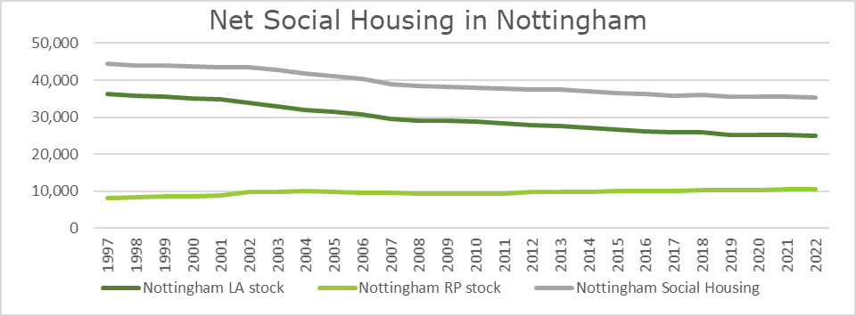
Decline of social housing
Notes:
Social housing has historically been there for people who can't afford to buy or rent their home - safe secure and affordable place to call home
As you can see on the screen the stock of social housing has been reducing.
Since the early 80s we've sold over 24,000 homes to the right to buy policy and this is about as many homes as are in to put that in context this is about as many homes as the council currently owns today
the council is still losing council homes through this policy over the last five years we've been averaging a rate of around 270 homes per year with the average discount of about £14 million
The council is building new homes and new registered providers have entered the social housing market but the loss of council homes has not been over offset by the number of new homes created
A significant number of homes brought under right to buy well now in the private rented sector commanding significant higher rent levels than they would compared to if they were still in the social housing stock

Slide 6
Private Rented Sector Affordability
Monthly figures
Notes:
As social housing becomes scarcer more and more people are having their housing needs met by the private rented sector
On the screen you can see the average lower quarter rents in Nottingham, April last year till March this April 2022 to March 2023
lower quarter rents here are considered entry level rents
You’ll also see that for households who require financial assistance via benefits to pay their rent are not having the full costs covered by the Local Housing Allowance and there is a deficit each month which they need to cover
These rent costs are generated by the Office of National Statists and tend to under evaluate the cost of new lettings advertised – it’s quite hard to find a 3 bed for £700 a month
English Housing Survey estimates that 24% of Nottingham’s private rented sector is classed as non-decent - not in a reasonable state of repair, lacking modern facilities, not effectively insulated or heated or with a hazard or immediate threat to a person’s health
18.1% of households in Nottingham experienced fuel poverty compared to 13.1% in England
lots of these household will be in the private rented sector - it's important that homes in this sector are affordable to heat.

Slide 7
Housing Challenges
Lack of availability of affordable homes to rent
Rising homelessness and rough sleeping
Quality of accommodation in rented sectors
Meeting the housing needs and aspirations of diverse communities
Impact on other services from inadequate housing provision or poor condition of homes
Notes:
So to summarise challenges for affordable housing
a lack of availability of affordable homes to rent
homelessness and rough sleeping is rising
the quality of accommodation in rented sectors
varying and diverse needs to meet
If people aren’t adequately housed this can impact on other services
Health services
Leon will know talk about existing affordable housing in the city

Slide 8
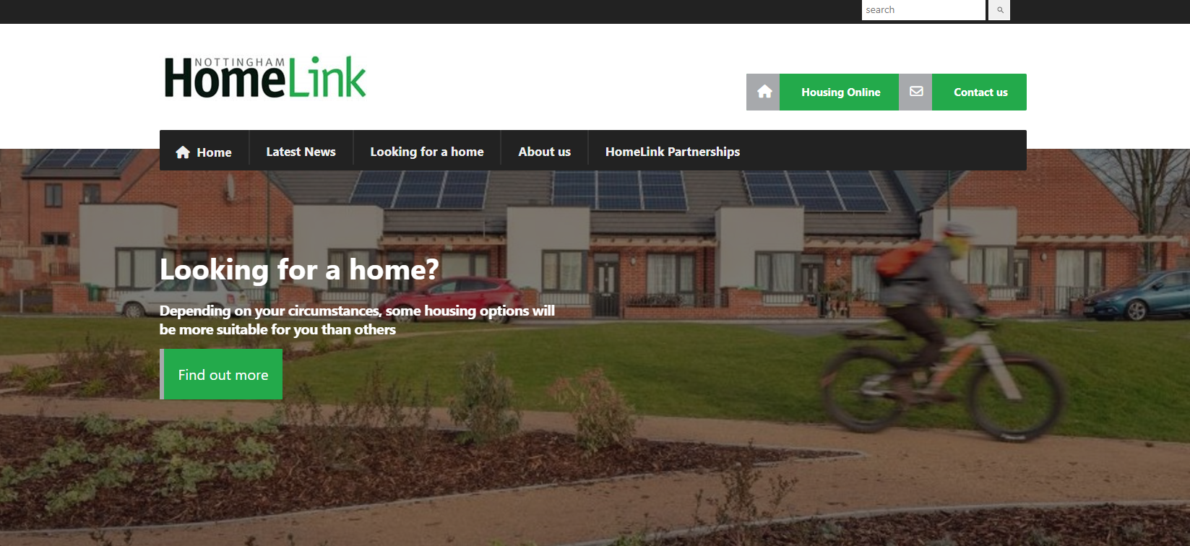
Housing Allocations
Lawful requirement to set out how the Local Authority allocates its homes
Housing Allocations Policy
Nottingham HomeLink Partnership
https://www.nottinghamcity.gov.uk/information-for-residents/housing/social-rented-housing/social-housing-allocations-policy
Notes:
LA with 24.5k properties
Stockholding LA- Part 6 – H-Act 96 – Requires a policy
Overview of partnership

Slide 9
Housing Register
Households are put into priority bands dependant upon circumstances
Banding | Title | Num
Band A | Urgent Need | 1,577
Band B | Moderate Need | 4,156
Band C | Singles & Couples | 2,770
Band D | Over 55’s Independent Living | 1,531
Household Type | Num
Single | 5270
Couple | 830
Family with 1 child | 1537
Family with 2 child | 1046
Family with 3 child | 679
Family with 4 child and over | 550
Unclassified (sub-list of Housing to Health or Victoria Centre applicants) | 122
Over 10,000 households on the Housing Register
*Housing Register as at October 2023
Notes:
Band A: Leaving Care / Severe Harassment & DA / Medical Grounds Severe Overcrowding
Band B: Families lodging / Homeless households / Overcrowded
Derby 13,000 on hous reg

Slide 10
Available Properties Demand
Let Properties
1150 Available Properties – 2021-22
1047 Available Properties – 2022-23
680 to date
September 2023
131 properties to advert
Property Type | Number
1 bed bungalow | 3
2 Bed bungalow | 18
1 bed flat | 66
2 Bed flat | 7
2 bed house | 22
3 bed house | 12
4 bed house | 1
2 bed maisonette | 2
Property Type | Average Bids Per Property
1 bed bungalow | 72
2 Bed bungalow | 33
1 bed flat | 170
2 Bed flat | 93
2 bed house | 259
3 bed house | 232
4 bed house | 61
Maisonette 2 bed | 136
Notes:
Yearly reduction
Other LA’s have witnessed the same
Housing people from 2017 – 2018 – Funnel effect, less properties more people trying to access thus creating a backlog

Slide 11
Advice to citizens
Alternative sources for accommodation
(Gumtree / DSS move / Rightmove / Zoopla)
Mutual Exchange
Do not limit bids
New Build
Bestwood – 129 new homes
Eastglade – 106 new homes
Padstow – 75 new homes
Ridgeway – 33 new homes
Notes:
Over 340 new homes being built between now and 2027

Slide 12

Homelessness in
Nottingham
Notes:
Over 340 new homes being built between now and 2027

Slide 13
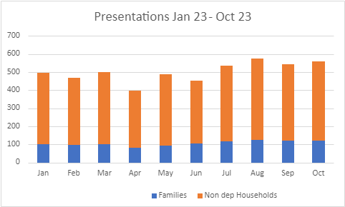

Homelessness
Notes:
Over 340 new homes being built between now and 2027

Slide 14
Reasons for
Homelessness
Friends / Family no longer willing or able to accommodate
Eviction from the Private Rented Sector
Notes:
Over 340 new homes being built between now and 2027

Slide 15
Temporary Accommodation
894 Households in temporary accommodation
179 Households in Hotel accommodation
31.10.2023 – 262 children in hotels
Average of 11 Families per week
Notes:
Over 340 new homes being built between now and 2027

Slide 16
Challenges
Lack of cooking facilities in hotels
Away from support networks / Schools
Increased time in temporary accommodation
Decreasing social housing sector
Lack of affordable accommodation
Cost of living
Notes:
Over 340 new homes being built between now and 2027

Slide 17
What can we do?
Notes:
Over 340 new homes being built between now and 2027

Slide 18
Prevent Where Possible
The offer of a Landlord Support Service to catch tenancy problems as early as possible.
“Say before you serve”
Early intervention Officers
Landlord Liaison Officers
Social lettings officers
Links into other support services
Notes:
Over 340 new homes being built between now and 2027

Slide 19
Our Offer
Personal Housing Plan created
Actions to take to prevent homelessness
Actions can be allocated to the tenant, landlord, housing aid staff or partner agency
Reviewed regularly
Support with:-
  Rent arrears
  Anti-social behaviour
  Disrepair
  Benefit issues
  Mediation
Notes:
Over 340 new homes being built between now and 2027

Slide 20
What do we need?
Good quality, affordable permanent homes in the Private Rented Sector
Notes:
Over 340 new homes being built between now and 2027

Slide 21
Tenancy Management
Written Bond equivalent of up to two months rent or Cash Deposit up to maximum of 5 weeks rent
Detailed inventory including photographs
Tenant Finding
Comprehensive assessment
Accompanied Viewings
Tenancy facilitation
Welfare benefits and direct payments of Universal Credit and Housing Benefit
Ongoing support
HHSRS inspections
Free
Notes:
Over 340 new homes being built between now and 2027

Slide 22
Property Management
Tenancy Management
Rent collection and account Management
Regular inspections
Co-ordinate repairs
Source contractors
Gas safety certificate
Check outs and inspections
Named officer contact
£35.00 per month incl. VAT
Notes:
Over 340 new homes being built between now and 2027

Slide 23
Rough Sleepers and
Ex-Offenders
Rent guarantee or 6 months RIA
Furniture support
Direct Rent Payments from Universal Credit
Setting up utilities
Rough sleeper and Ex Offender specialists
Notes:
Over 340 new homes being built between now and 2027

Slide 24
Achievements
2022/2023
Currently Managing 53 Properties
396 Households supported into accommodation
86 Ex offenders assisted into accommodation
118 Rough sleepers supported off the streets into accommodation
Notes:
Over 340 new homes being built between now and 2027

Slide 25
Need to do more
Landlords
Further support for the NPRAS, through service re-design
  Manager Support
  Landlord Liaison Officer
  Casework intervention officers
  Social lettings officers
Notes:
Over 340 new homes being built between now and 2027

Slide 26


Contact Details
Tel 0115 8761644,
Email NPRAS@nottinghamcity.gov.uk,
Web npras.co.uk,
@NottmPRAS
@NottmPRAS
Notes:
Over 340 new homes being built between now and 2027

Slide 27
Temporary Accommodation
  Thank you for Listen
  Any Questions?
Notes:
Over 340 new homes being built between now and 2027

