Slide 2
Where to find the right funder and Support for your project
Christine Salaman 11/11/2020

Slide 3
Transformation Cornwall Resources
Meet the funders Main event https://transformation-cornwall.org.uk/resources/meet-the-funders-main-spring-event-resources
Resource Document https://togethernetwork.org.uk/uploads/shared/MtF-Resource-Document.pdf
Grants list updated weekly
https://transformation-cornwall.org.uk/resources/transformation-cornwall-grants-list

Slide 5
Truro Diocese Resources
Church Grants https://truro.churchgrants.co.uk/
You will need your parish reference number – contact Christine if you don’t know it
Funds for Mission https://trurodiocese.org.uk/resources/parish-resources/funds-for-mission/

Slide 6
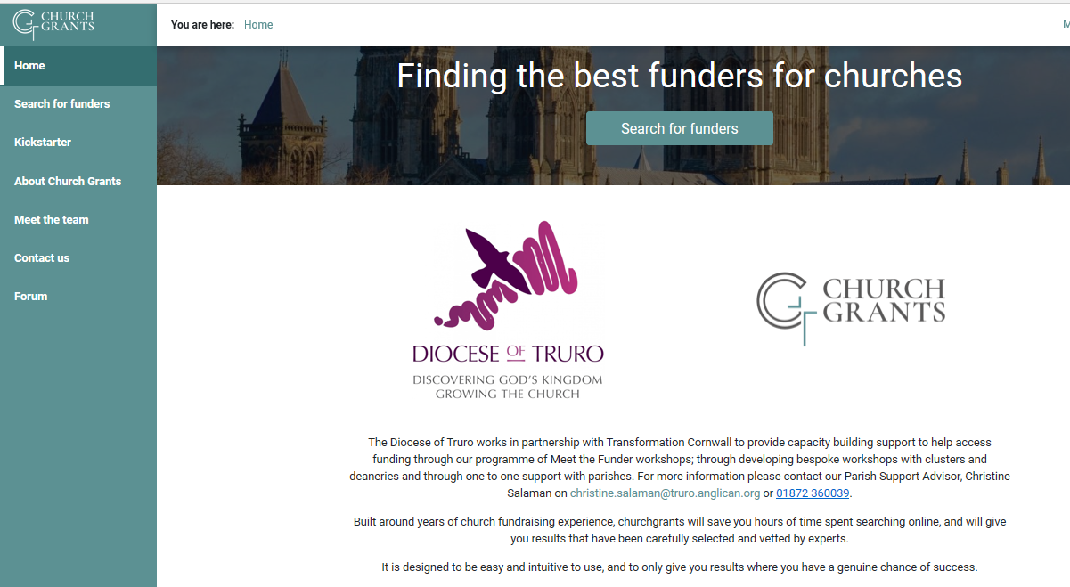

Slide 8
Other places to try
Charitable Grants for Churches
https://www.parishresources.org.uk/wp-content/uploads/Charitable-Grants-for-Churches-Jul-2020.pdf
Cornwall Community Foundation emergency fund and local grants list : https://www.cornwallcommunityfoundation.com/introduction-to-grants/available-grants/
Local Councils
Ecclesiastical: list of funders for grants during Covid19 and beyond plus tips on fundraising
https://www.ecclesiastical.com/church/fundraising/

Slide 11
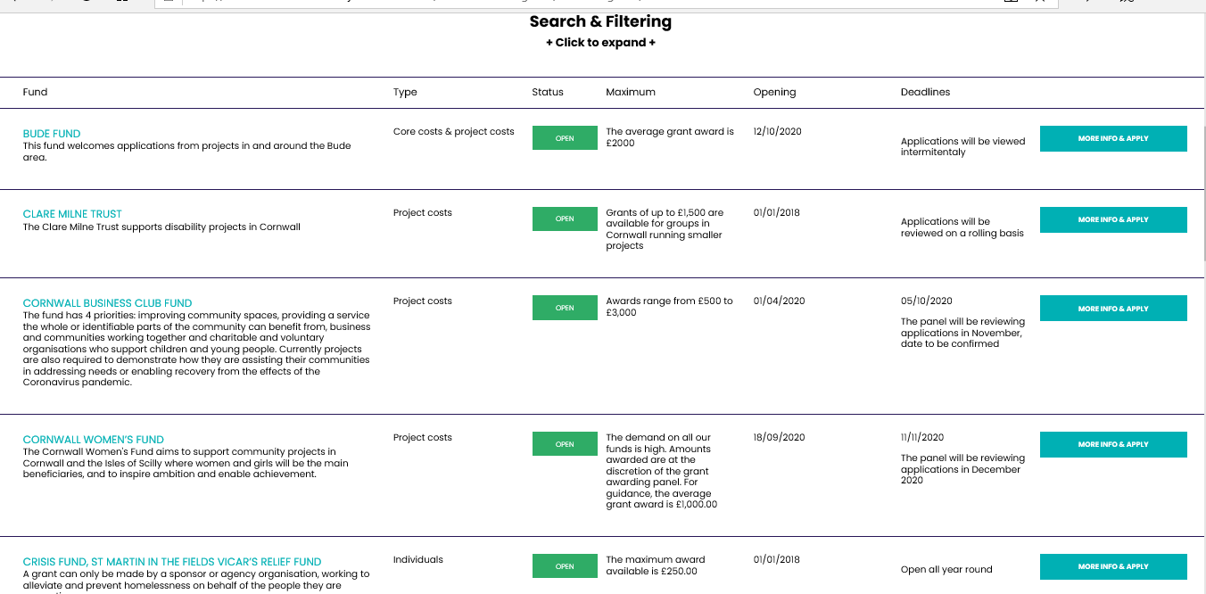
Cornwall Community Foundation

Slide 12
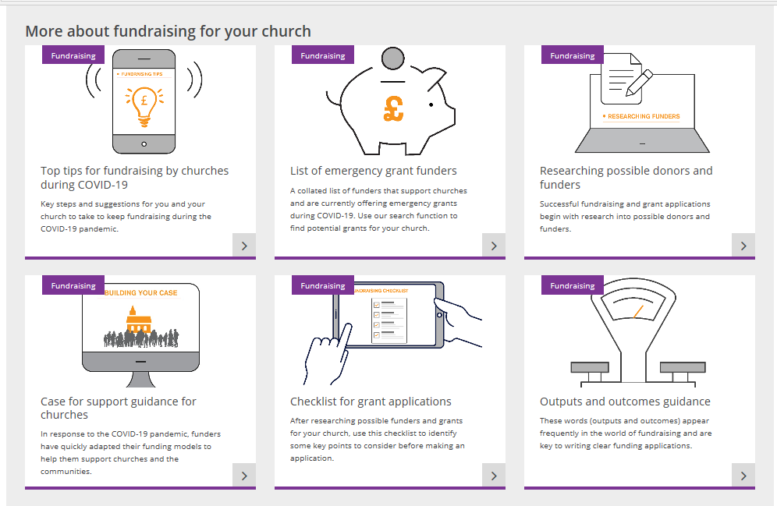
Ecclesiatical

Slide 13
A few Key funders
All Churches Trust
https://www.allchurches.co.uk/
Cornwall Historic Churches Trust
https://www.chct.info/
National Churches Trust
https://www.nationalchurchestrust.org/our-grants
National Lottery Community Fund
https://www.tnlcommunityfund.org.uk/
National Lottery Heritage Fund
https://www.heritagefund.org.uk/

Slide 14
Christine Salaman, Parish Support Advisor
christine.salaman@truro.anglican.org

Slide 15
Future Meet the funders Workshops
Weds 25th Nov 11am Surgery 3: Understanding key questions in a funding application and where to look for potential funders
Thurs 3rd Dec, 2.00-3.30pm: funders Workshop. Grant managers from the National Lottery community fund, All Churches Trust, Cornwall Community Foundation, Groundworks South West ( Tesco bags of help and Comic Relief funds),
https://transformation-cornwall.org.uk/areas-of-work/meet-the-funders
(information, booking links, recordings)
https://trurodiocese.org.uk/resources/parish-resources/stewardship/meet-the-funders/
(booking links, workshop webinar recordings)

